Slide 1
PSY100 Tutorial Chapter 11
June 15, 2012

Slide 2
What shapes development?
Gene x environment interaction
Genes: predictable progression
(eg. roll→sit→crawl...etc)
Environment: eg. sleep on back ←→ crawling
In the womb:
Genes: brain development
(basic brain→cortex→thalamus→right vs left hems)
Environment:
Teratogens – agents (eg. drugs, bacteria, viruses) that can impair physical and cognitive development in the womb
Eg. Fetal alcohol syndrome

Slide 3
Brain Development
2 important aspects:
Regions mature and become functional
Regions learn to communicate via synapses
Myelination → synapse formation
Synaptic pruning – frequently used connections preserved, unused ones decay and disappear (“use it or lose it”)
Critical vs sensitive periods

Slide 4
Attachment
Attachment – strong, intimate connection that persists over time and across circumstances
In infants, leads to increased feelings of safety
Attachment styles:
Secure (65% of children)
Avoidant (20-25%)
Anxious-ambivalent (10-15%)
Variants of above styles, eg. disorganized
Chemical oxytocin plays a role
Strange-Situation
Test

Slide 5
Infant Research Techniques
Preferential-looking technique
Orienting reflex
Infants look longer at new stimuli than old
Used to measure recognition of old vs new
vs
See if infant looks
longer at one item

Slide 6
Piaget’s Stages of Development
Sensorimotor (birth – 2 years old)
Only aquire info through senses
Object permanence
Preoperational (2 – 7 yo)
Symbolic thinking
Concrete operational (7 – 12 yo)
Logical thinking (eg. classic operations)
Formal operational (12 yo – adulthood)
Abstract thinking (eg. testing hypothesis)

Slide 7
Piaget, cont.
At each stage, children develop new schemas (ways of thinking)
Assimilation: new experience into old schema
Accomodation: schema changed to fit new info
Criticisms:
Not all children go through stages in same order
Not all children use same logic to solve problems

Slide 8
Learning Through Interactions
Theory of mind – ability to explain and predict another’s behaviour based on recognizing his or her mental state
Young children better than originally thought
Eg. toy-handing experiment, false-belief test
Kohlberg’s stages of moral reasoning:
Preconventional: based on self-interest
Conventional: conform to rules/laws
Postcoventional: based on abstract principles

Slide 9
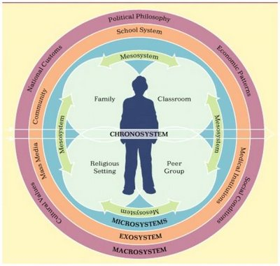
Identity Formation
Bronfenbrenner’s biocultural systems theory:
Group socialization theory: inside vs outside home

Slide 10
Gender Identity
Sex vs Gender ←→ Biology vs Culture
Gender identity – personal belief about being male or female
Gender roles – culturally defined norms that differentiate characteristics of males vs females
Gender schemas – cognitive structures that influence how people perceive behaviours of males and females

Slide 11
?Questions?

